Slide 4
Seminar 4: Lung Cancer

Slide 5
Task 1

Slide 6
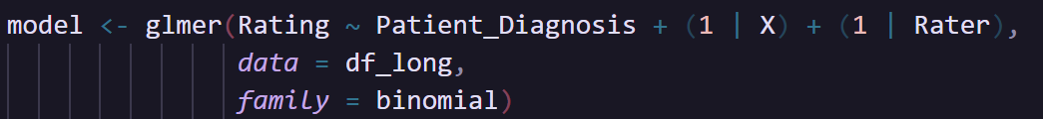
Introduction
Analyzing the agreement between 2 raters
Data: 2 columns of lung cancer screening results from 2 raters, and 1 column of actual patient diagnosis
Methodology: Kappa calculation, ICC calculation, confusion matrix (sensitivity, specificity, etc), general linear mixed model

Slide 7
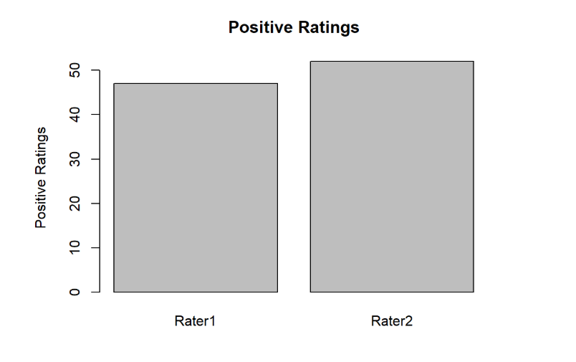
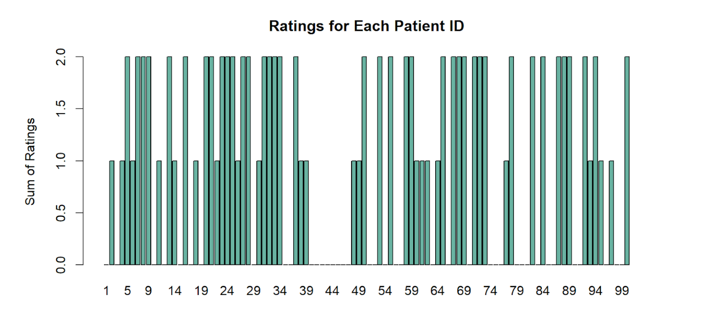
Visualizations
Count of Positive Ratings
Sum of Ratings

Slide 8
Results
ICC
ICC | P-value | 95% CI | F(99,100)
0.583 | 6.65e-11 | [0.438,0.699] | 3.8
Fleiss' Kappa
Cohen's Kappa
Kappa | Z | p-value
0.58 | 5.8 | 6.65e-09
Kappa | Z | p-value
0.581 | 5.84 | 5.25e-09
Moderate agreement
p-values < 0.05 indicate that we can reject the null hypothesis and that the agreement between the raters is not only due to chance.
ICC indicates moderate to good consistency in the ratings

Slide 9
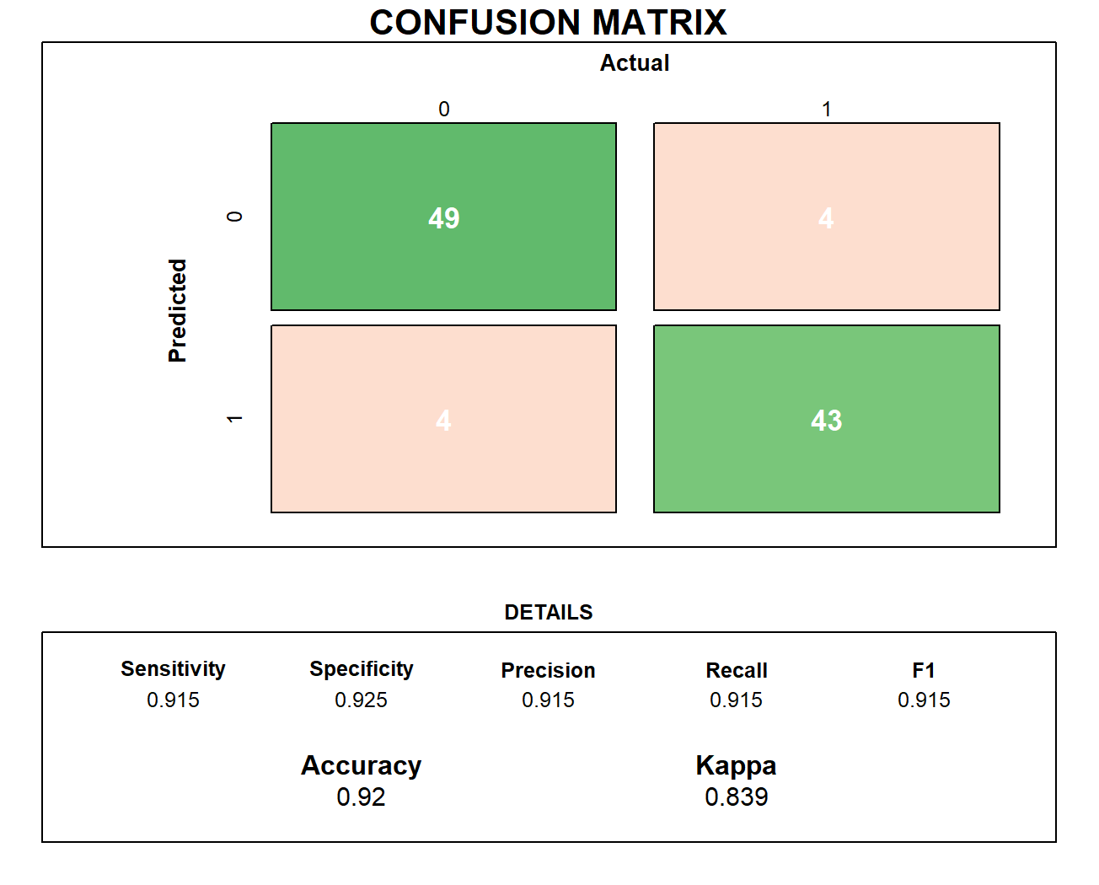
Results – Confusion Matrix
McNemar's p-value = 1
P-value (Acc>NIR) = <2e-16
McNemar’s p-value of 1 indicates that there is no significant difference between the rater and the actual diagnosis.

Slide 10
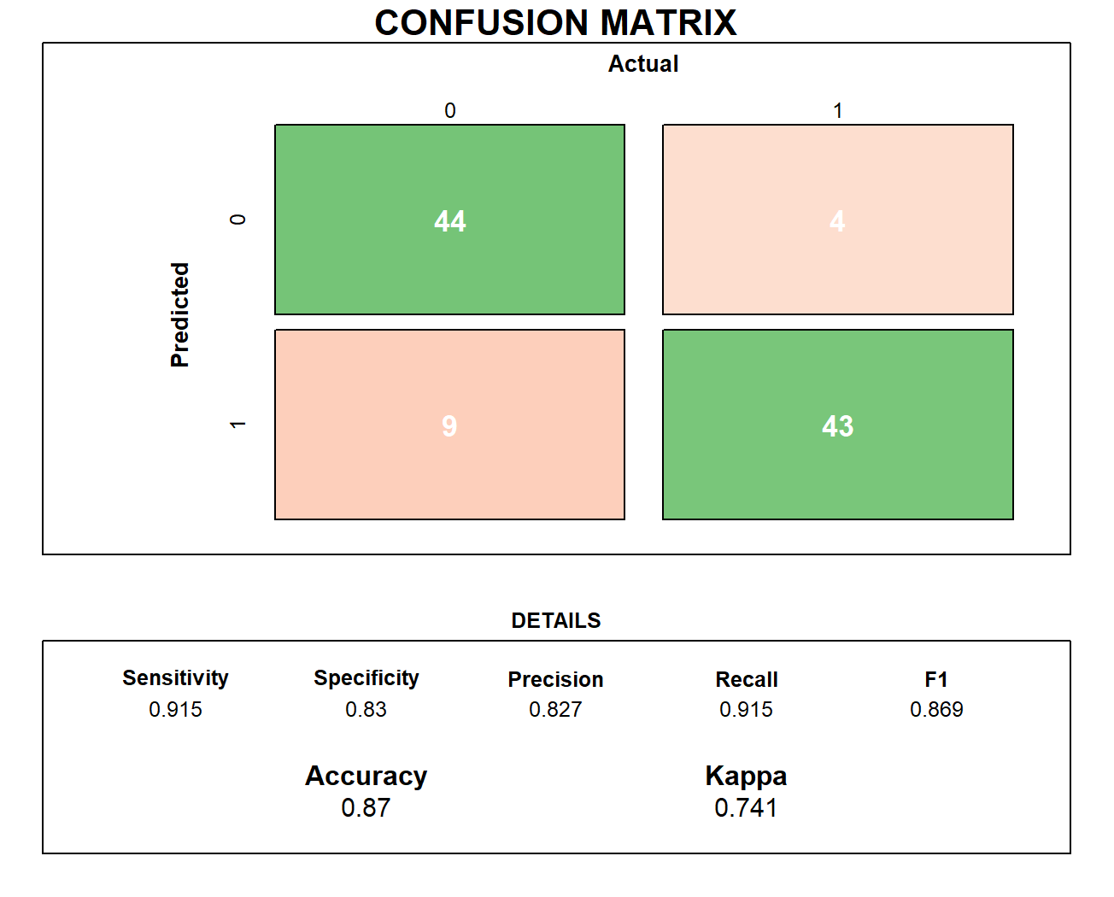
Results – Confusion Matrix
McNemar's p-value = 0.2673
P-value (Acc>NIR) = 4.774e-13
Lower F1-score than rater 1

Slide 11
Results – Generalized Linear Mixed Effects Model
Fixed Effects
 | Estimate Std | Error | Z-value | Pr(>|z|)
(Intercept) | -1.9677 | 0.2961 | -6.645 | 3.03e-11
Patient_Diagnosis | 4.3426 | 0.4736 | 9.169 | < 2e-16
Random effects of the raters is 0, which means there is not much observed difference between the raters.
This is consistent with the Kappa values of 0.58, which indicate moderate agreement.​
Strong positive effect
If patient’s diagnosis is positive or 1 -> log-odds increase by 4.34
Odds ratio at exp(4.34) = 76.7 -> raters are 76.7 times more likely to assign 1 or positive when the diagnosis is truly positive.
If patient diagnosis is 0, or at the intercept -> odds ratio is exp(-1.9677) = 0.14.

Slide 12
Conclusion
Moderate agreement between 2 raters shown by Kappa + ICC scores
Kappa p-values < 0.05 indicate that we can reject the null hypothesis and that the agreement between the raters is not only due to chance.
Rater 1 had higher F1-score than Rater 2
Raters are 76.7 times more likely to assign 1 or positive when the diagnosis is truly positive.

Slide 13
Task 2

Slide 14
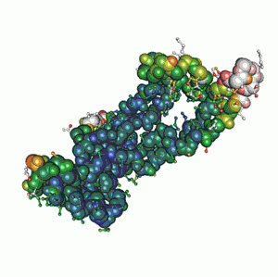
Introduction
♋ Cyfra 21-1 biomarker for detecting non-small cell lung cancer (NSCLC)
🧬 Analytical kits measures concentration in [ng/mL]
🧑🏻‍⚕️ Problems in medicine:
  Different kits yield same result?
  A doctor might diagnose or miss cancer depending on the kit used.
Are Kit 1 and Kit 2 interchangeable?
https://www.raybiotech.com/cyfra-21-1-antigen-md-28-0001p

Slide 15
Method – workflow
Data imported and analyzed in R (v4.5.1)
Paired dataset ⟹ direct comparisons Kit 1 vs. Kit 2 possible
Exploratory Data Analysis (EDA) to understand patterns
Summary statistics computed for both kits
Statistical analysis using various techniques

Slide 16
Method – statistical analysis
Scatterplot & Regression – visual assessment
Correlation – linear association between Kit 1 and Kit 2
Paired comparison (t-test) – systematic bias (i.e., one always higher)?
Bland-Altman analysis – accuracy (bias) & precision (variation)
Clinical decision threshold – sensitivity & specificity
Cohen’s kappa (κ) – categorical agreement beyond chance

Slide 17
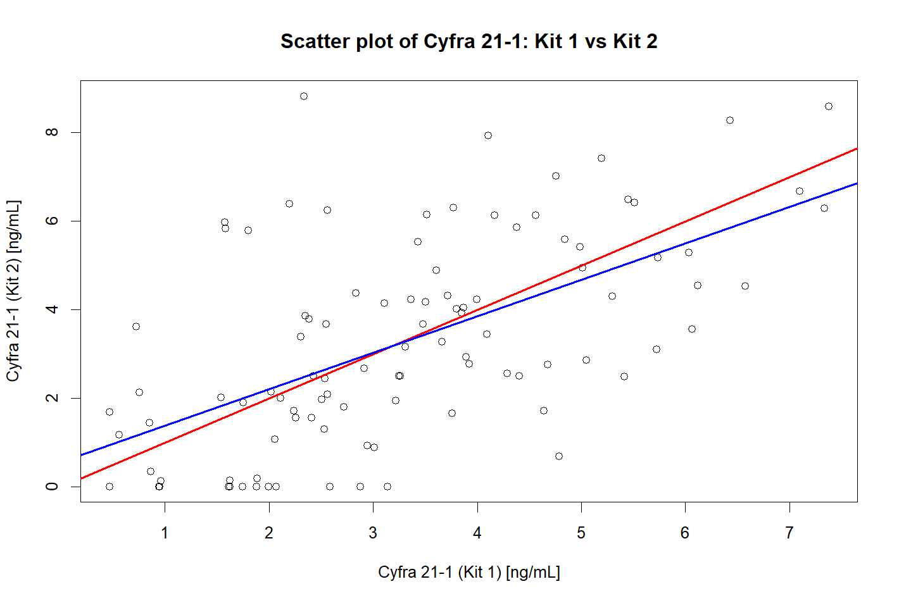
Results (1-3)
Regression line close to identity (k=1) line
  Minimal difference (proportional bias)
Pearson correlation coefficient
  r = 0.5846311 ⟹ moderate relationship
  If one kit increases, the other does too.
Paired t-test: p = 0.9166
  Insignificant mean difference ⟹ low bias (high accuracy)
Further tests needed...

Slide 18
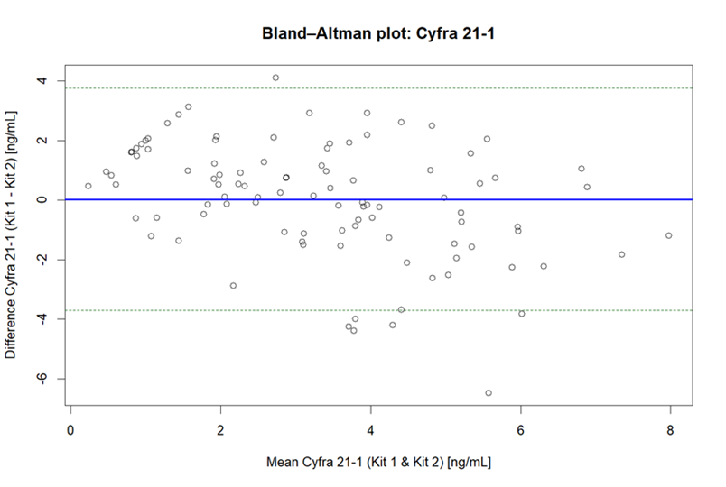
Results (4) – Bland-Altman analysis
Near-zero mean difference
  ⟹ high accuracy (low bias)
  Consistent with previous results.
Wide Limits of Agreement (LOA)
  ⟹ low precision (high variation)
  Kits do not align on individual measurements.

Slide 19
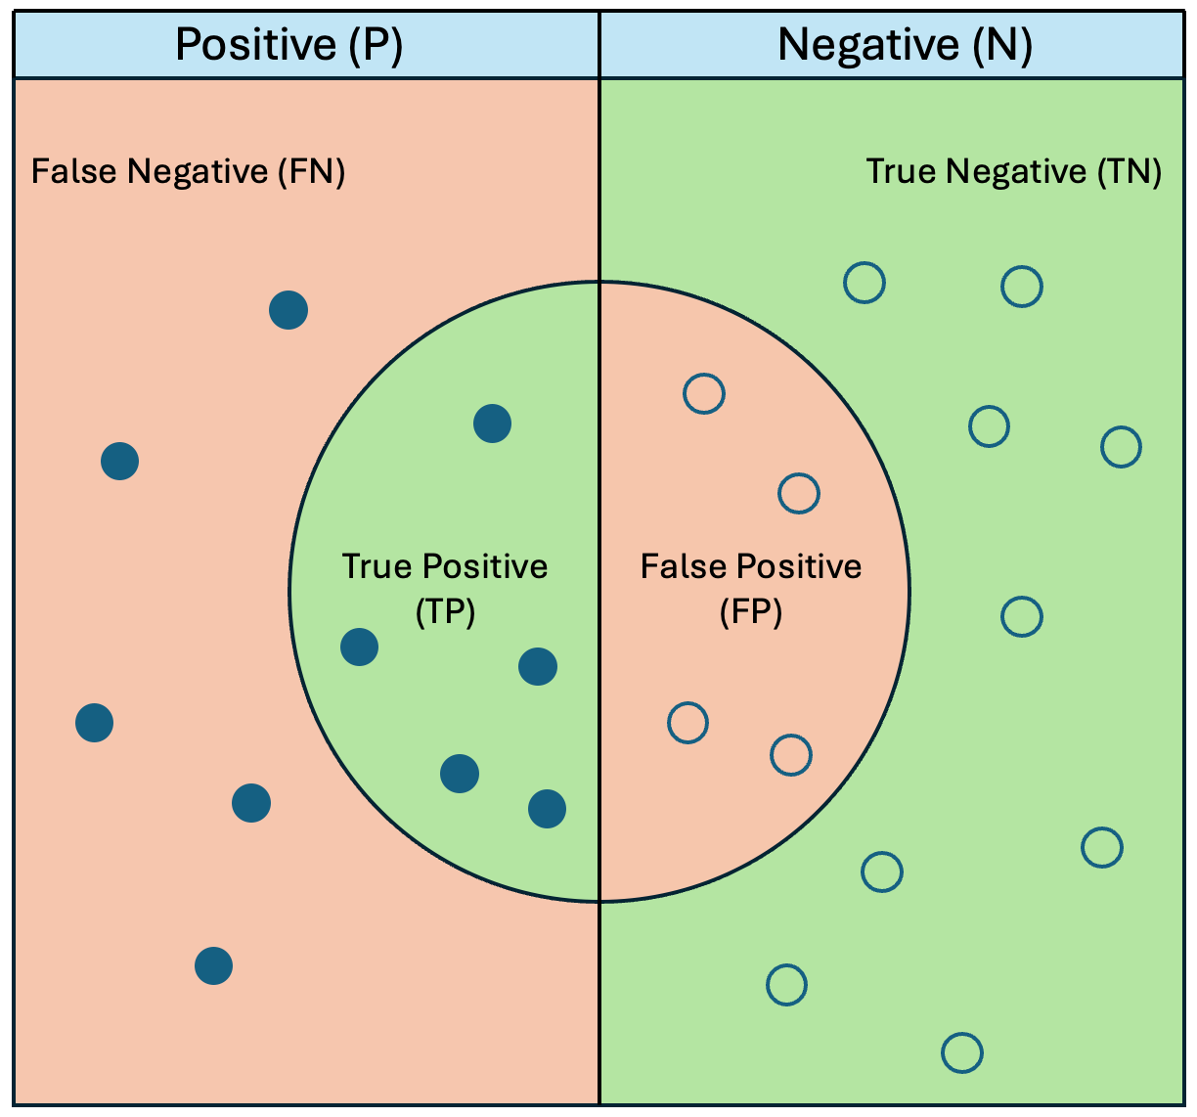
Results (5) – Sensitivity & Specificity
A clinical decision threshold set to 3.3 ng/mL
  If concentration is below, patient is classified as negative.
  Else, patient is classified as positive.
  Check agreement of Kit 1 with Kit 2 (treated as reference).
Sensitivity (72%)
  ⟹ Kit 1 misses 28% of the positive cases that Kit 2 identifies.
  ⟹ Instead, 28% are classified as (false) negatives.
Specificity (75%)
  ⟹ Kit 1 misses 25% of the negative cases that Kit 2 identifies.
  ⟹ Instead, 25% are classified as (false) positives.
https://medium.com/trusted-data-science-haleon/specificity-and-sensitivity-in-data-science-9d0c19b102ab

Slide 20
Results (6) – Cohen’s kappa
Same clinical decision threshold of 3.3 ng/mL
  ⟹ Check for categorical (positive/negative) agreement beyond chance.
Acceptable κ-levels
  < 0.40 ⟹ Poor
  0.41–0.60 ⟹ Moderate
  0.61–0.80 ⟹ Good
  0.80 ⟹ Excellent / interchangeable
κ = 0.48
  ⟹ Only moderate categorical agreement.
  ⟹ Not acceptable for diagnostics.

Slide 21
Conclusion
Interchangeable ≈ Agreement = no bias + no variability
  ⟹ Bland-Altman is the optimal approach.
Consistency between different statistical analyses
  ⟹ high accuracy, low precision.
Too low sensitivity (72%) and specificity (75%) for clinical reliability
  ⟹ Consistent clinical interpretation cannot be ensured.
Cohen’s kappa (κ = 0.48) indicated only moderate agreement beyond chance
Ultimately, Kit 1 and Kit 2 are not interchangeable!

Slide 22
Task 3

Slide 23
The task
Carcinoembryonic antigen (CEA) is a biomarker that has shown potential for detecting and monitoring cancer.
This task investigated agreement of 100 CEA measurements across five quantitative Enzyme-linked immunoabsorbent assays (Elisa).
Visualise with plots and summary statistics
Bland-Altman plots
Mixed-effects model + ICC

Slide 24
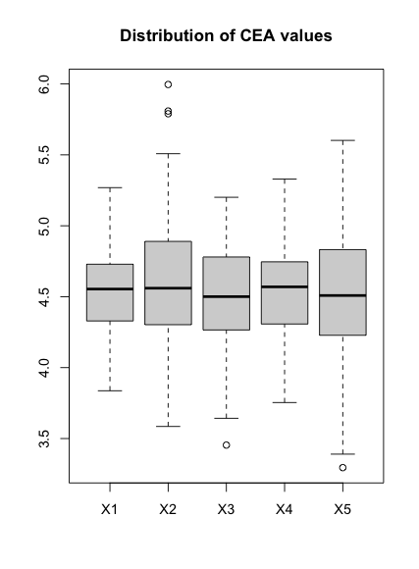
Visualisations
Boxplot:
  Showed similar overall CEA measurements.
    Similar means and maximum/minimum values.
  X2 had a slightly higher maximum, and X3 and X5 slightly lower minimums.
  Values range mostly between 3.5 and 5.5
Pairwise correlation plot:
  Relatively high correlations between all assays.
  Scatterplots showed linear relationships.
  All assays appeared normally or near-normally distributed, some were slightly skewed.

Slide 25
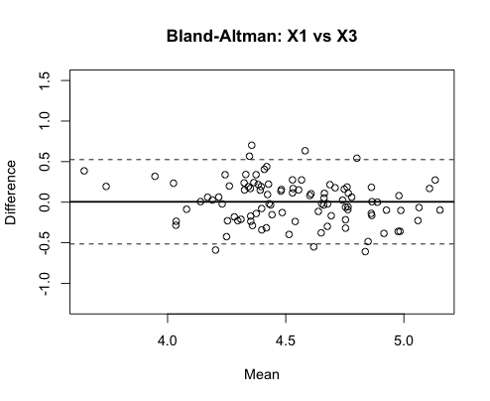
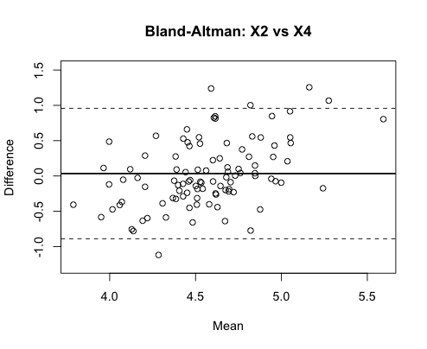

Bland-Altman plots
Mean difference near 0 for all pairs -> low bias.
Most differences ranged between +/- 0.6 to 1 unit.
Four pairs displayed some proportional bias, meaning differences got larger for larger measurement values.
Overall looked quite good, but differences > 1 are quite big as measurements ranged from ~3-5
No proportional bias
Some proportional bias

Slide 26
Mixed-effects modelling
Mixed-effects model with assay as fixed effect, and subject as random intercept.
Fixed-effects estimates
 | Estimate | p-value
(Intercept) (X1) | 4.53 | < 2e-16
Assay X2 | 0.047 | 0.236
Assay X3 | -0.005 | 0.904
Assay X4 | 0.013 | 0.740
Assay X5 | -0.017 | 0.673
Fixed-effects estimates showed no significant differences between assays + estimated differences were small.
Also from model:
  Between-subject standard deviation = 0.248.
  Within-subject residual variance = 0.283.
  ICC = 0.44
A two-way icc checking for agreement for single raters was also calculated. Yielded ICC = 0.44.

Slide 27
Conclusion
Assays produced similar CEA measurements:
  Low mean differences, no statistically significant fixed-effects differences.
The mixed effects-model indicated that between-subject SD and within-subject residual variance were of similar size, meaning actual differences between subjects were rougly of the same magnitude as measurement errors.
An ICC value of 0.44 indicates relatively poor agreement.
So: assays produced similar overall results, but agreement was poor. Individual measurements are therefore not interchangeable.

Slide 28
Task 4
External Validation of a Lung-Cancer Risk Prediction Model

Slide 29
Data & Objectives
Data
  1000 patients
  True outcome: cancer vs no cancer
  Model output: predicted probability of cancer
Aim of Task 4
  Evaluate how well the model performs in an independent dataset
  Inspect discrimination (AUC), classification thresholds, and calibration
  Decide which threshold is clinically appropriate

Slide 30
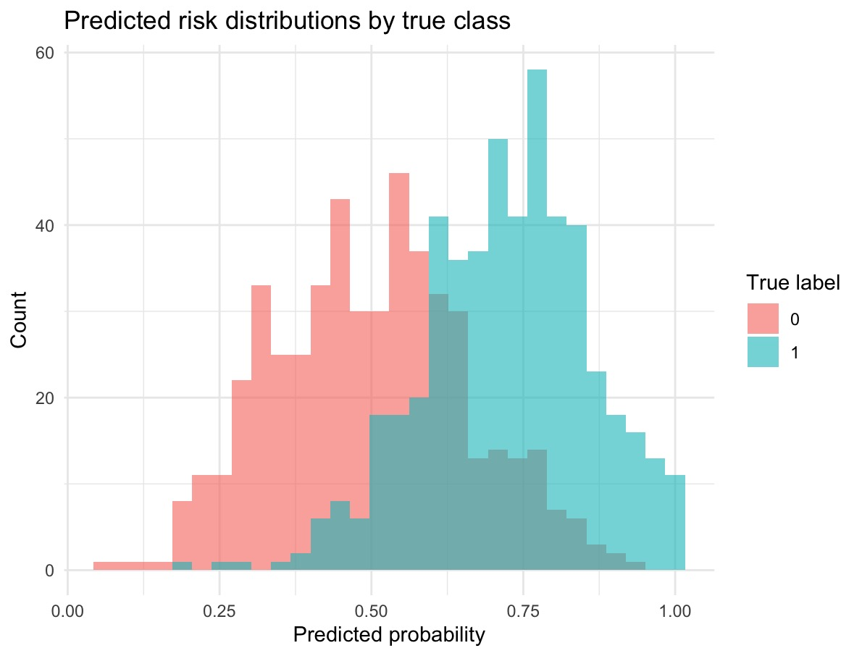
Predicted Probability Distributions
Shows how predicted risks differ between cancer (1) vs non-cancer (0) patients
There is clear separation but also substantial overlap, meaning no threshold will perfectly separate the groups
This overlap explains why sensitivity and specificity change as the threshold moves
Cancer and non-cancer risks overlap → threshold choice matters.

Slide 31
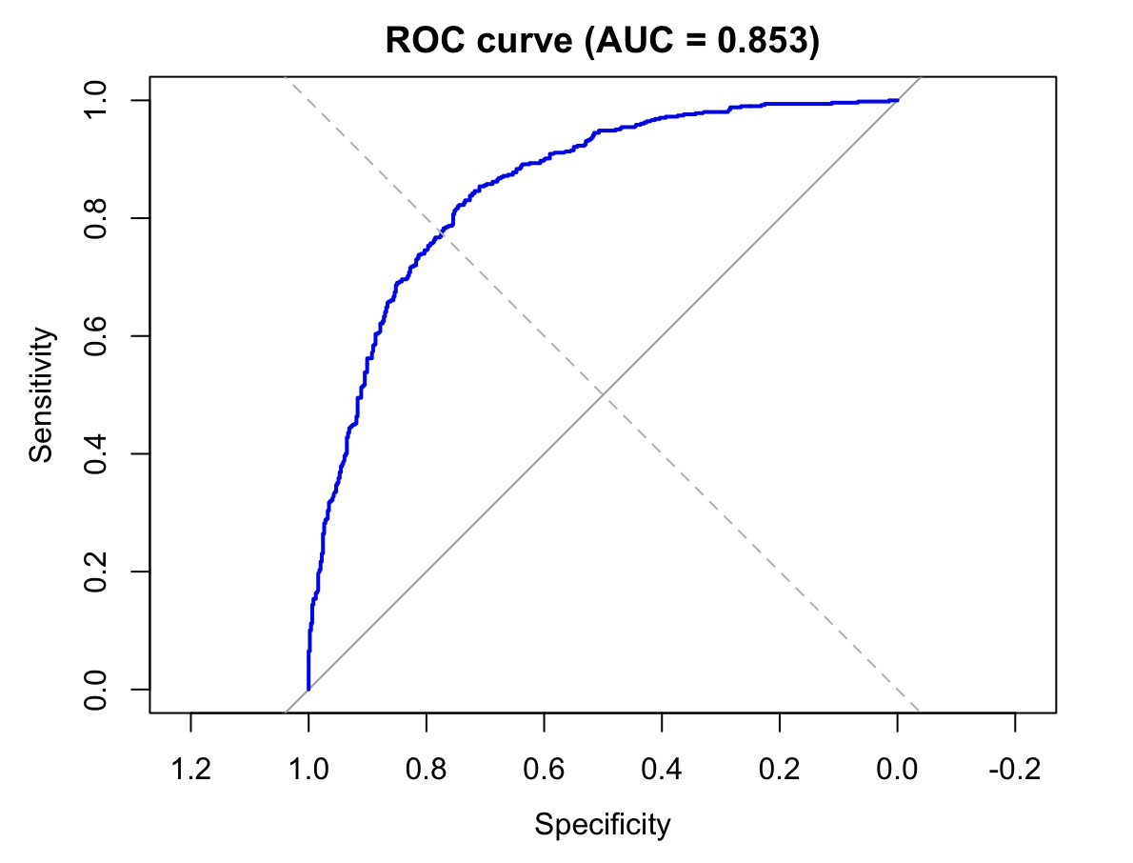
Discrimination (ROC & AUC)
AUC = 0.85 (95% CI: 0.83–0.88)
Indicates good ability to rank patients by risk
Consistent separation between classes

Slide 32
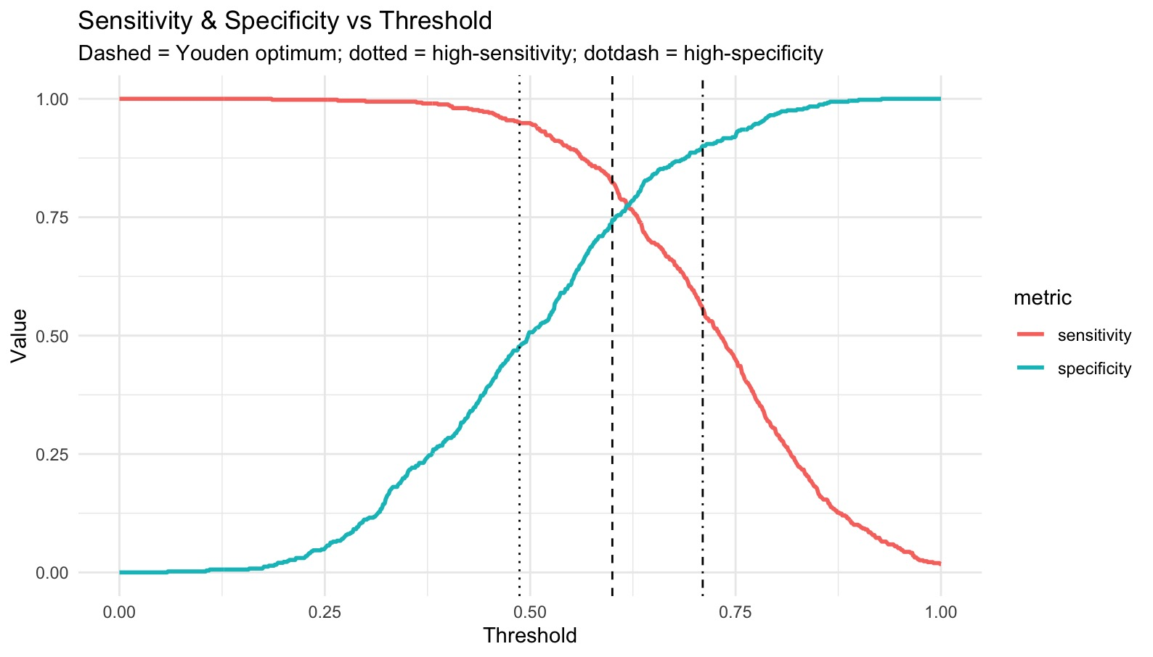
Threshold Performance
Threshold sweep from 0 to 1
Sensitivity falls as the threshold increases
Specificity rises as the threshold increases
No single cutoff is ideal because of class overlap
Choice of threshold depends on clinical priority

Slide 33
Threshold Performance
Threshold | Sens | Spec | Notes
0.5 (default) | 0.95 | 0.51 | High sensitivity, moderate NPV → suitable for screening
0.49 (high-sens target) | 0.95 | 0.48 | Captures almost all cancers; more false positives
0.6 (Youden) | 0.82 | 0.74 | Best balance, but misses more cancers
0.71 (high-spec) | 0.56 | 0.90 | Good at ruling-in, not for initial screening

Slide 34
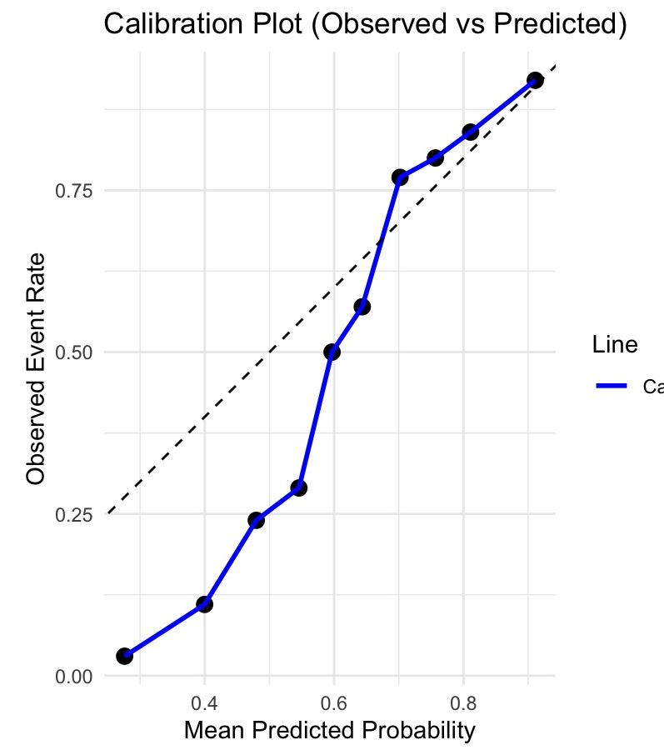
Calibration (Deciles)
Hosmer–Lemeshow
Shows the models ability to predict risks consistently
p < 0.001 → evidence of miscalibration
Low-risk groups: model overestimates risk
High-risk groups: predictions align well with observed rates
Brier score
measure overall accuracy of probabilistic predictions of the model.
0.18 → moderate probability accuracy
Overall: probabilities are not perfectly calibrated

Slide 35
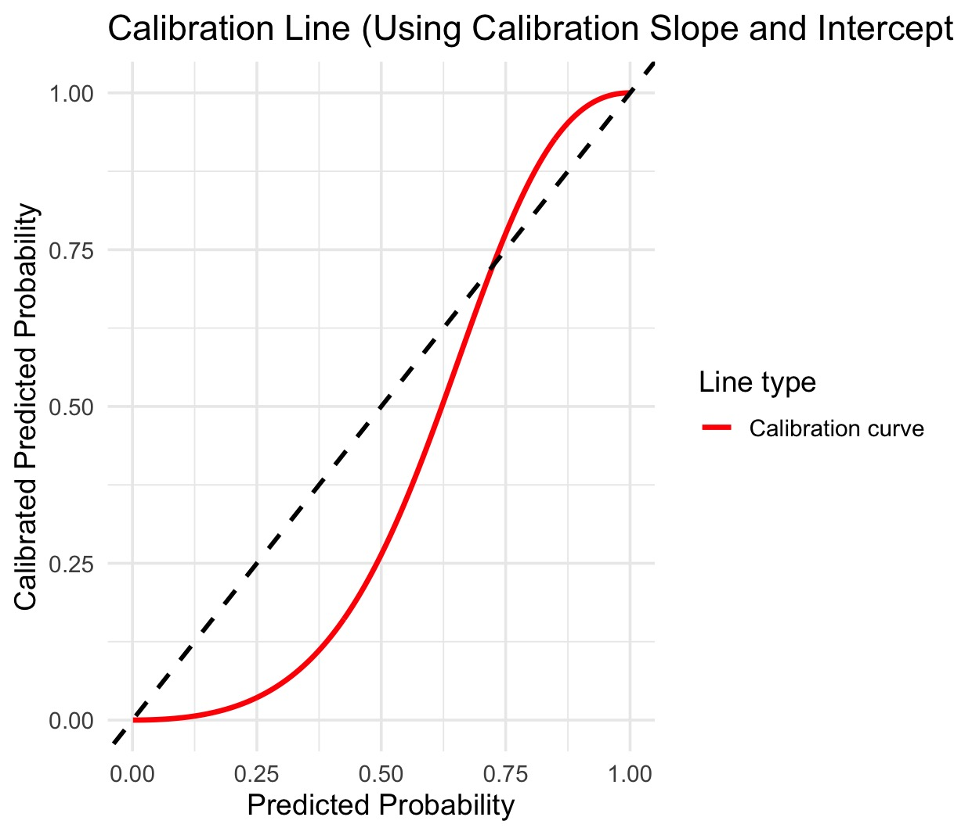
Calibration (Slope & Intercept)
Intercept ≈ –1.03 → model overpredicts risk overall
Slope ≈ 2.06 → probability curve too steep
Deviation from 45° line → predicted probabilities need recalibration

Slide 36
Clinical Interpretation
What the model is good at:
  Detecting cancer with high sensitivity
  Ranking patients by risk (good AUC)
What the model struggles with:
  Overestimates low-risk cases
  Produces imperfect probability estimates
  Requires recalibration before being used for actual risk communication
Best clinical use:
A high-sensitivity threshold (~0.49) for triage or screening, where avoiding missed cancers is the priority.

Slide 37
Conclusion
Strong discrimination (AUC 0.85) but imperfect calibration
Threshold choice depends on priorities → for lung cancer detection, sensitivity dominates
Use a high-sensitivity threshold for screening; calibrate the predicted probabilities before clinical deployment

